Slide 1

Bus guide and location reminder system (Muthopath)
Project Co-Supervisor
Debbrata Kumar Saha
Lecturer
Computer Science & Engineering
State University of Bangladesh
Project Members
1. Arefin Newaz Prince
ID: UG02-29-12-035
2. Hemendra Rupak Biswas
ID: UG02-29-12-026
3. Rashedul Karim
ID: UG02-29-12-030
Project Supervisor
Dr. Bilkis Jamal Ferdosi
Head of the Department
Computer Science & Engineering
State University of Bangladesh

Slide 2
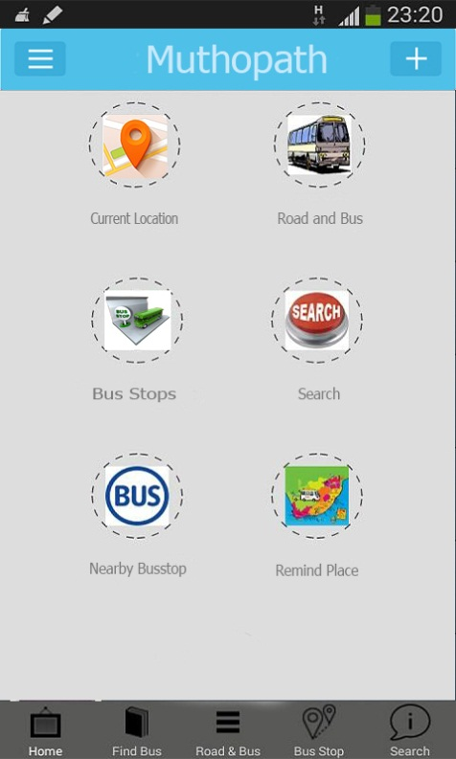
Project Overview
Tracking User’s own location and nearby bus stops.
Easier to select bus where he/she has to go and can calculate the distance.
User can observe real time movement.
Notified the user when he/she reach the nearest/desired scheduled destination.
Can detect nearest paired device.

Slide 3
System Flowchart
Bus Info Entry
Bus info
Bus Info
Bus List
report
Bus stops entry
Stops info
Stops Info
Stops List
report
User location
User loc info
Location Info
Location List
report
Remind Entry
Schedule info
Remind Info
Remind List
report
Google Map

Slide 4
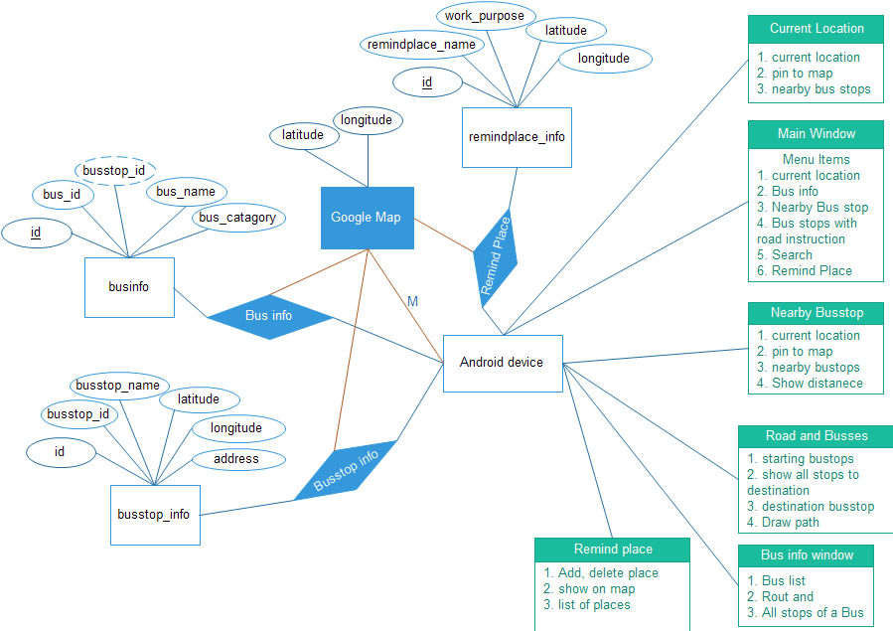
E-r diagram

Slide 5
Database Sample
busses
id | bus_id | busstops_id | b_name | b_catagory
1 | b1 | bs_1 | Citybus | local
2 | b1 | bs_2 | Citybus | “
3 | b1 | bs_3 | Citybus | “
4 | b1 | bs_4 | Citybus | “
5 | b1 | bs_5 | Citybus | “
6 | b2 | bs_1 | Nishargha | citying service
7 | b2 | bs_2 | Nishargha | “
8 | b2 | bs_3 | Nishargha | “

Slide 6
busstops
id | busstop_id | bs_name | locX | locY
1 | bs_1 | Mohammadpur | 23.765845 | 90.358338
2 | bs_2 | Shankar | 23.751696 | 90.367365
3 | bs_3 | Jighatala | 23.737547 | 90.376392
4 | bs_4 | Shahbagh | 23.723398 | 90.385419
5 | bs_5 | Motijhil | 23.709249 | 90.394446

Slide 7
remind_place
id | place_name | working-purpose | locX | locY
1 | Muhammadpur | Meet with x | 23.77853 | 90.379166
2 | Gulistan | Shoping | 23.751696 | 90.367365

Slide 8

Main Window
Window properties
This is the main window
Here menu are given at the bottom
Each have separate functions and separate window

Slide 9
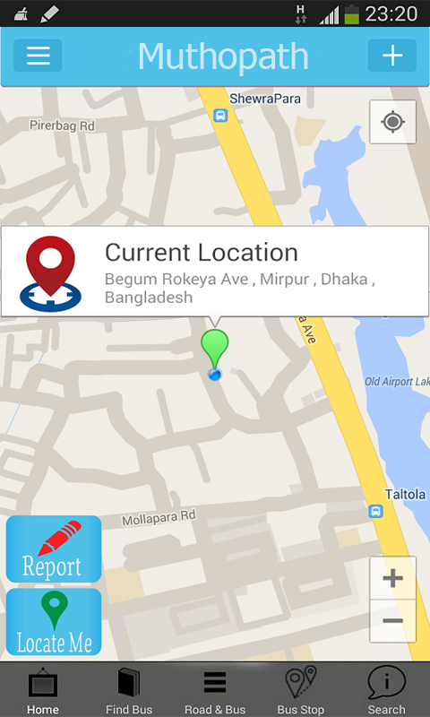
Current location Window
Window properties
This window is for showing current location of user.
Nearby bus stops (likely 5/6) are shown.
On click address will be shown.

Slide 10
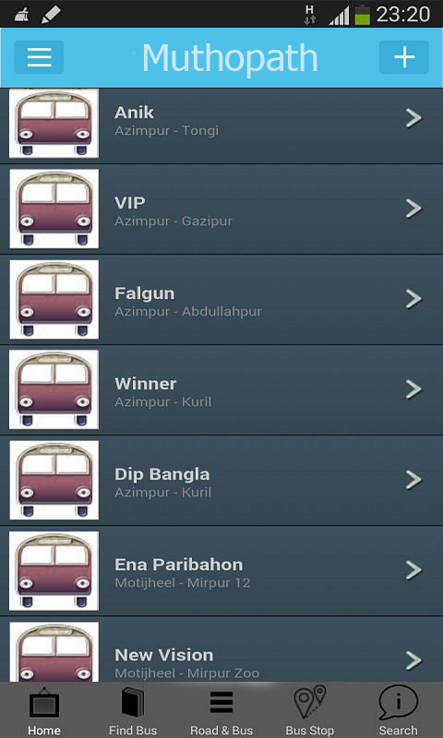
Bus info Window
Window properties
Shows the all bus with their stops.
Can show bus path on map by clicking.
Every stops are pinned for a particular bus.

Slide 11
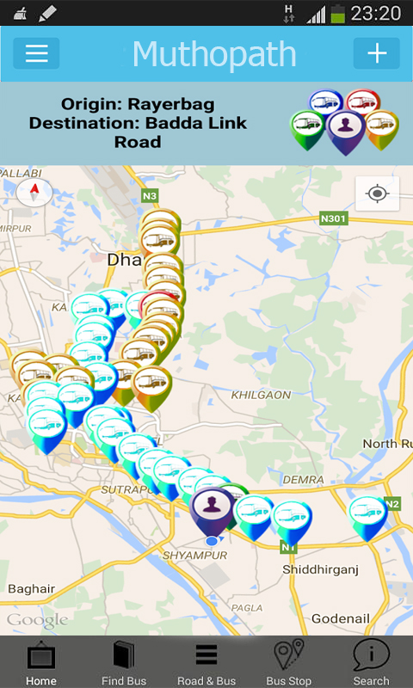
Road and Bus stops Window
Window properties
Shows up path from source to destination.
Shows the all stops of selected bus.
Nearest bus icon color is different.

Slide 12
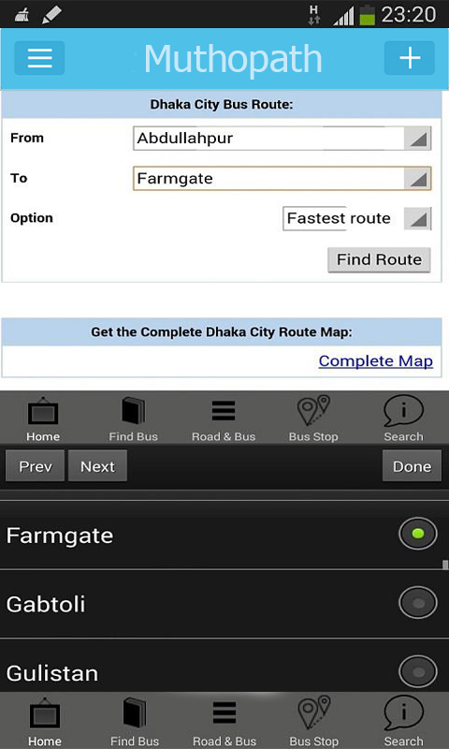
Search Window
Window properties
Can select source and destination by dropdown list.
Find out bus and shortest road suggestion .

Slide 13
Thank You

